Slide 1
GBF Conference Room Scheduling
Training – Jan 2020

Slide 2
Agenda
What will this training cover?
How to schedule a GBF conference room (large and small conf rooms)
How do I change a meeting and/or conference room once scheduled
Recurring meetings and impact on conference rooms
What to do if a GBF conference room is not available
When can we start scheduling our own conference rooms?
Questions/ further help and Thank You

Slide 3
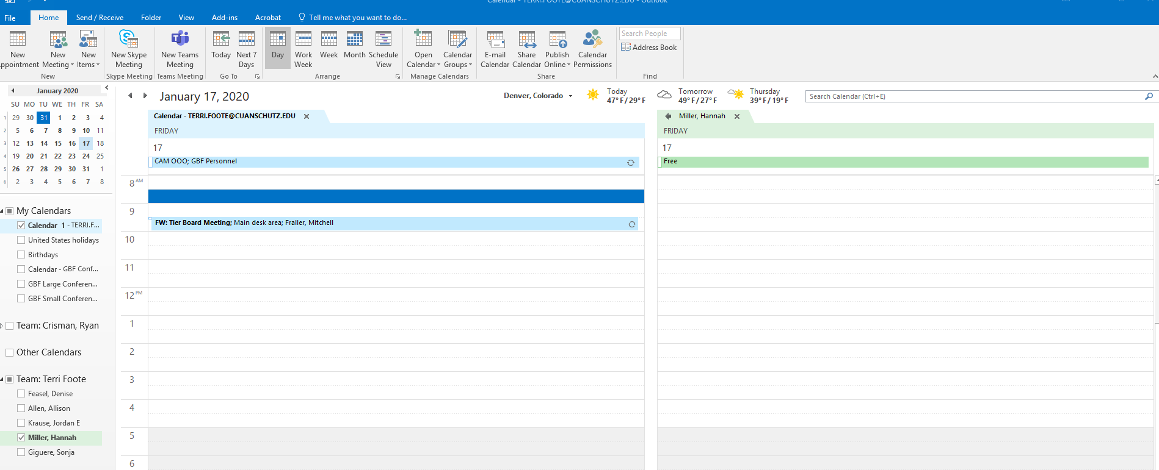
Step 1: Set up attendees for meeting

Slide 4
Step 2: Fill out appointment info
Fill out meeting subject
Leave location blank
Propose estimated day and time

Slide 5
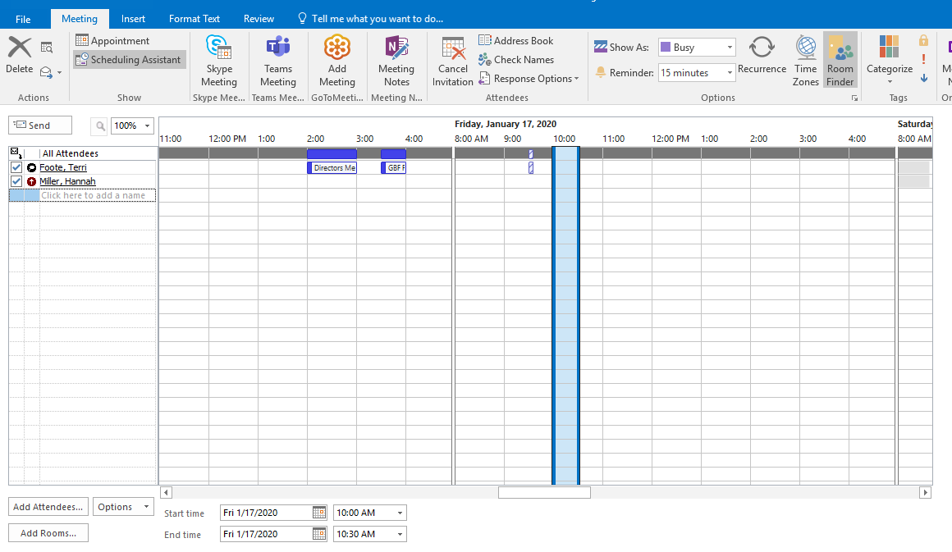
Step 3: Move to adding conference room
Click on “Scheduling Assistant”
Click “Add Rooms…”

Slide 6
Step 4: Conference rooms
This screen will appear……

Slide 7
Step 5: Locate GBF conference rooms
Type in “GBF”
The two GBF conference rooms will be visible
Click on the conference room to highlight
Click on “rooms” to add for preview of availability

Slide 8
Step 6: Add GBF conference room
The conference room will appear in the “Rooms” line
Press “OK”

Slide 9
Step 7: Review available times
1. Screen will now show calendars for invitees and conference room

Slide 10
Step 8: Highlight available time
Find available time
Press “Appointment” to ensure all information and conference room is included

Slide 11
Step 9: Verify meeting information and schedule meeting with Room
Ensure all information is complete and accurate:
Invitees – meeting attendees + conference room
Subject
Location => conference room
Start day/time
End day/time
Meeting agenda, notes, comments
PRESS Send

Slide 12
Step 10: Verify meeting was scheduled
Go to meeting on your calendar and click on the meeting
Click on scheduling assistant
Be care not to move the meeting within the scheduling bar.
Simply “X” out of this screen

Slide 13
Scheduling both conference rooms

Slide 14
Scheduling both conference rooms

Slide 15
Meeting changes
Go to meeting on your calendar and click on the meeting
Click on scheduling assistant
To change time or date…find available time and click “send”

Slide 16
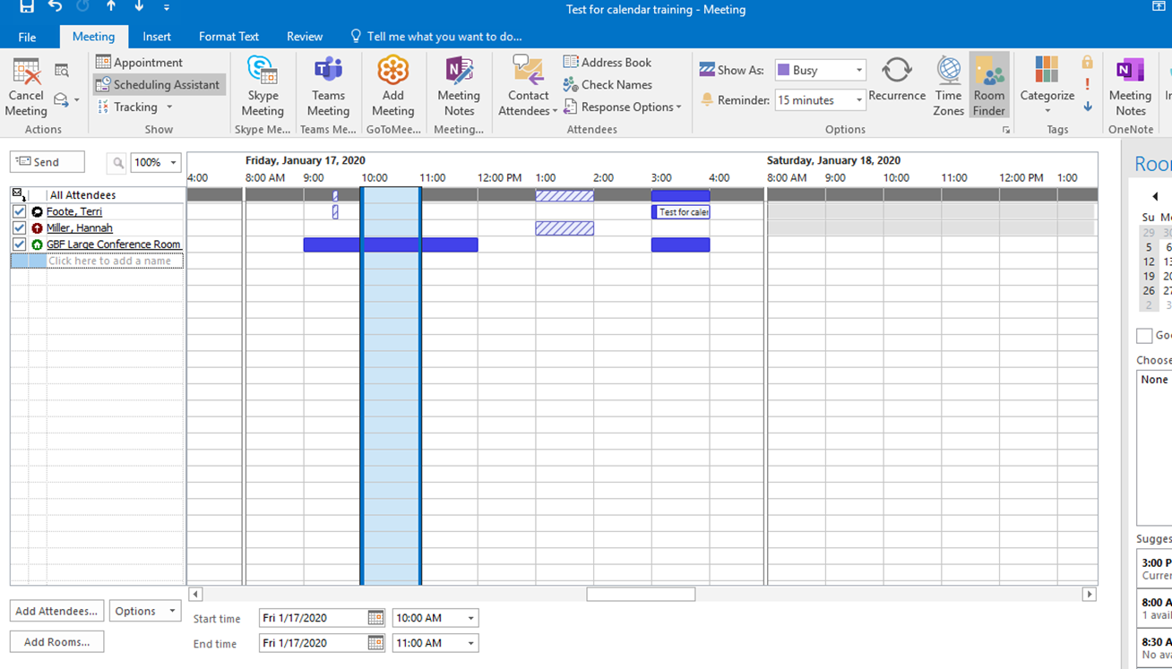
Please be aware….
People can be overbooked but Conference rooms cannot be double booked
System will allow this meeting to be scheduled BUT
The conference room will not be scheduled despite what your calendar states…see next slide

Slide 17
Scheduling over another meeting in a conference room…..
Looks like it is scheduled in Large conference Room….but it is not
MUST be aware of email messages!!

Slide 18
Conference room was not scheduled

Slide 19
Caution: Conference room invite declined
However, this may not be obvious when reviewed on the calendar….
Meeting Initiators MUST pay attention to email messages

Slide 20
Recurring Meetings
Please be aware of the following…..
“Request was denied” emails for conference rooms for dates your meeting was not able to be booked in the conference room
Currently, meetings are scheduled through February (Emily Feasel scheduled) – See next slide
If you are the leader/owner of a recurring meeting, please go in now and set up your meetings to include your desired conference room to begin in March.

Slide 21
Recurring Meetings
Meeting | Room | Time | Days | Owner
Cell Therapy | Large Conference Room | 9:30-10:00 (9:00-10:00 on Friday's) | Everyday | Mitchell
Protein Meeting | Large Conference Room | 10:00-11:00 | Monday | Branden
Neon Client Meeting | Large Conference Room | 2:00-3:00 | Monday | Jordan
Protein Deviation Mrg | Small Conference Room | 11:00-12:00 | Tuesday | Sarah
QC/QA/Materials Deviation Mtg | ?? | 2:00 -3:00p | Wednesday | Sarah
Quality Meeting | Large Conference Room | 3:00-4:00 | Bi-Weekly: Monday | Chris G
QC Meeting | Large Conference Room | 3:00-4:00 | Wednesday | Chris F
Schnauzer Meeting | Large Conference Room | 11:00-12:00 | Thursday | Sonja
Directors Meeting | Large Conference Room | 2:00-3:30 | Thursday | Directors - Rotate
Forecast Meeting | Large Conference Room | 3:30-4:00 | Thursday | Denise
Neon Client (Internal) Meeting | Large Conference Room | 10:00-11:00 | Friday | Jordan
CT Deviation Meeting | Large Conference Room | 11:000-12:00 | Friday | Sarah
Safety Meeting | Large Conference Room | 1:00-2:30 | Friday (2nd Friday of the month) | Chris F
QC On Point Meeting | Small Conference Room | 10:00-11:00 | Mondays | Chris F
SOP Meeting | Small Conference Room | 2:00-3:00 | Monday | Terri
QA Meeting | Small Conference Room | 10:00-11:00 | Tuesdays | Chandresh
Change Control - CT | ?? | 10:00-11:00 | Wednesday (every other week) | Mitchell
Not scheduled through Feb at this time

Slide 22
What if I cannot find an available GBF Conference Room or one that will work for my meeting?
Contact Admin Assistance
(Hannah through Jan. 17 and then Kate Swisher)
They will try to find a room within BS1 or BS2
Contact Anschutz Campus Library
General areas in FRA
Other ideas or options ?????

Slide 23
To the conference room schedule
Open Calendar
Click on Room List
Type in “GBF” and enter

Slide 24
To the conference room schedule…
Add GBF Large and GBF Small Conference room by highlighting and pressing “Rooms” button

Slide 25
You will now be able to see the calendar for the conference rooms….
The conference rooms should show up on the left side of your calendar and when “checked” you can see the conference room calendars

Slide 26
When can we start scheduling GBF Conference Rooms??
Today ☺ !
HOWEVER please note:
Recurring meetings have been scheduled through February (by Emily)
Double check your conference rooms before and after scheduling
Pay attention to the “Request was Denied” emails.
Please be patient with each other while we all get the hang of this
Please work together to resolve any conflicts that may arise
If there are too many issues, we will need to go back to the old way of scheduling conference rooms through the Administrative Group.

Slide 27
Questions and further help
Please see Hannah or Terri if you have any questions or want additional help
Special “Thank You” and shout out for helping us implement this….
Zach Spears
Hannah Miller
Emily Feasel

